Slide 1


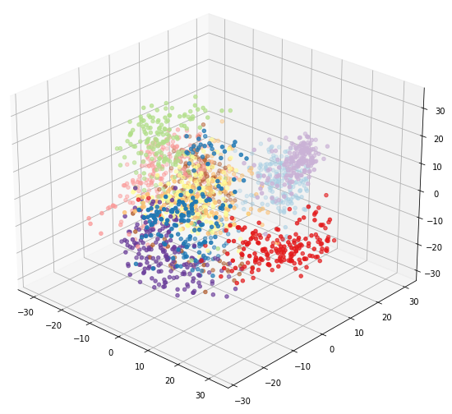


LINEAR ALGEBRA
P.C.A
MACHINE LEARNING
Get Started

Slide 2

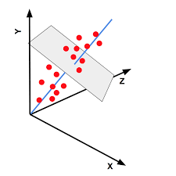
P.C.A
PRINCIPAL COMPONENT ANALYSIS
Principal components analysis (PCA) is a technique that can be used to simplify a dataset
It mean to reduce the dimension of a large dataset without loosing important information
It is a linear transformation that chooses a new coordinate system for the data set such that greatest variance by any projection of the data set comes to lie on the first axis (then called the first principal component), the second greatest variance on the second axis, and so on.
2020
Next Page

Slide 3
P.C.A
PRINCIPAL COMPONENT ANALYSIS
Principal Component Analysis (PCA) is a statistical method used for reducing the dimensionality of high-dimensional data while preserving most of its important information. It does this by transforming the original variables into a new set of variables, called principal components, which are linear combinations of the original variables.
1. Dimensionality Reduction: PCA helps in simplifying the complexity of high-dimensional data by projecting it onto a lower-dimensional subspace.
2. Orthogonal Transformation: PCA transforms the original variables into a set of linearly uncorrelated variables called principal components.
3. Variance Maximization: The first principal component accounts for the maximum variance in the data, followed by subsequent components in decreasing order of variance. This means that the first few principal components capture most of the variability in the data.
4. Eigenvalue Decomposition: PCA typically involves computing the eigenvalues and eigenvectors of the covariance matrix of the original data. The eigenvectors represent the directions of maximum variance, while the eigenvalues indicate the amount of variance explained by each eigenvector.
5. Component Interpretation: Each principal component is a linear combination of the original variables, and they represent different patterns or directions of variation in the data. These components can be interpreted to understand the underlying structure of the data.
6. Data Reconstruction: PCA allows for the reconstruction of the original data from the principal components, albeit with some loss of information due to dimensionality reduction.
PCA is widely used in various fields such as machine learning, data visualization, feature extraction, and noise reduction. It helps in uncovering the underlying structure in high-dimensional data and simplifying complex datasets for easier analysis and interpretation.
Principal components analysis (PCA) is a technique that can be used to simplify a dataset
2020
Next Page

Slide 4
P.C.A
PCA rely on following Mathematical Concept:-
Linear Algebra: PCA involves matrix operations extensively. The mathematical foundation of PCA lies in linear algebra, particularly in concepts such as eigenvectors, eigenvalues, matrix multiplication, and singular value decomposition (SVD). These concepts are used to compute the principal components, which are the eigenvectors of the covariance matrix of the data.
Covariance Matrix: PCA begins with the computation of the covariance matrix of the dataset. The covariance matrix summarizes the relationships between different variables in the dataset. Mathematically, the covariance between two variables is calculated as the product of their standard deviations and the correlation between them.
Eigenvalue Decomposition or SVD: Once the covariance matrix is computed, PCA seeks its eigenvectors and eigenvalues. Eigenvectors represent the directions of maximum variance in the dataset, while eigenvalues quantify the amount of variance explained by each eigenvector. PCA typically involves finding the eigenvectors and eigenvalues of the covariance matrix using techniques like eigenvalue decomposition or singular value decomposition.
Dimensionality Reduction: The primary goal of PCA is to reduce the dimensionality of the dataset while preserving as much information as possible. This is achieved by selecting a subset of the eigenvectors (principal components) that capture the most variance in the data. The mathematical operation involved in dimensionality reduction is a projection of the original data onto the subspace spanned by the selected principal components.
Variance Explained: PCA allows us to understand how much variance in the data is explained by each principal component. This is important for determining the number of principal components to retain. Mathematically, the proportion of explained variance by each principal component is calculated as the ratio of its eigenvalue to the sum of all eigenvalues.
Data Reconstruction: PCA can also be used to reconstruct the original data from the reduced-dimensional representation. This is achieved by projecting the reduced data back onto the original high-dimensional space. The mathematical operation involved in data reconstruction is the inverse transformation using the selected principal components.
Principal components analysis (PCA) is a technique that can be used to simplify a dataset
2020
Next Page

Slide 5
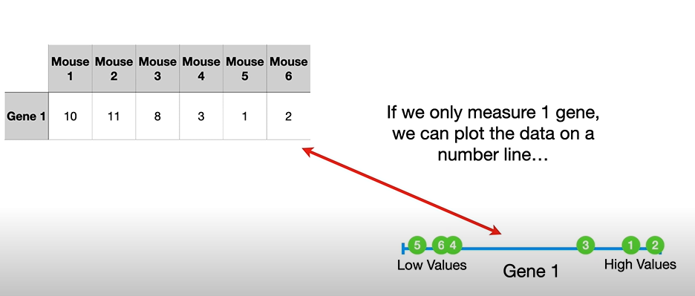
EXAMPLE
Let’s Take Some Random Dataset
Sets with big data is on right side and smaller data is on left side
2020
Next Page

Slide 6

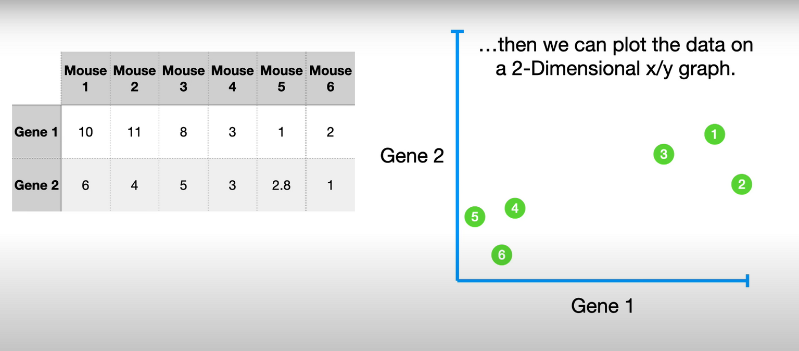
EXAMPLE
Larger data Right Side
Smaller data Left Side
WITH 2-D DATASET
Presentations are tools that can be used as lectures, speeches, reports, and more It is mostly
Next Page

Slide 7
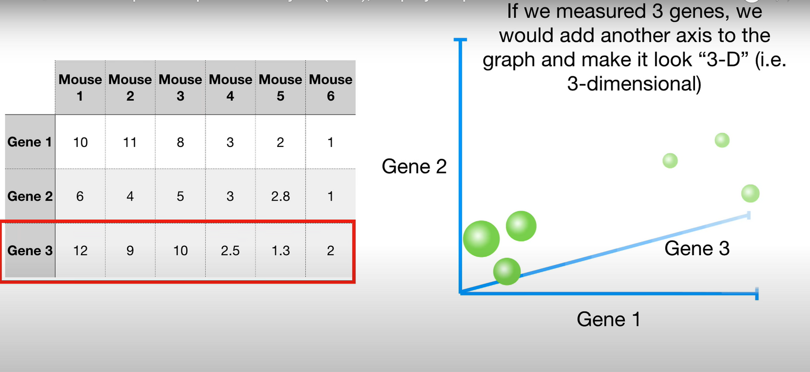
EXAMPLE
Same goes for 3-D also
WITH 3-D DATASET
Next Page

Slide 8
OBSERVATION
FROM ALL THE ABOVE SLIDES WE CAN OBSERVE THAT
Specific data which has bigger sets or bigger information stays and behave different from smaller sets
That’s why it’s easy to compress and delete smaller sets of info
2020
Next Page

Slide 9
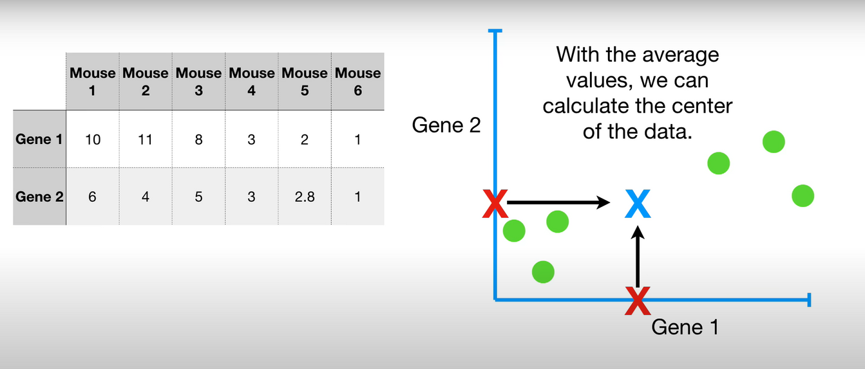
LET’S SEE HOW PCA WORKS
To Understand what PCA does how it works let’s go back to the dataset that had only 2 genes
Let’s find X (avg(gen-1) , avg(gen-2) )
Next Page

Slide 10
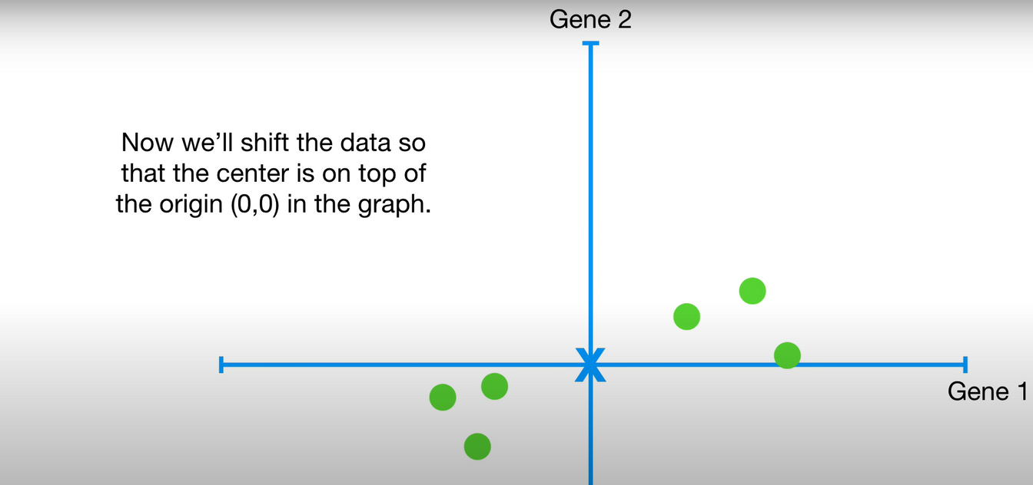
Shifting of Data
Relative data will not change
Now Let’s find the best fitting line
Next Page

Slide 11
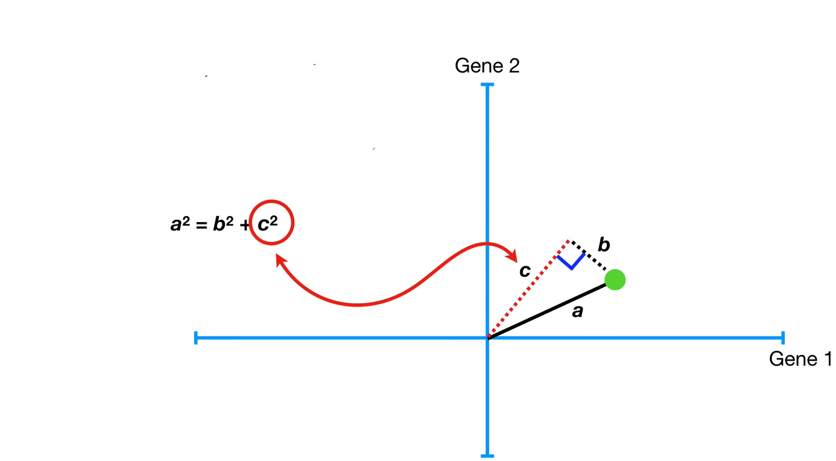
PCA can either minimize the distance to the line or maximize the distance from the projected point from the origin
PCA find the best fitting line by maximizing the sum of the squared distances from the projected points to the origin
2020
Next Page

Slide 12
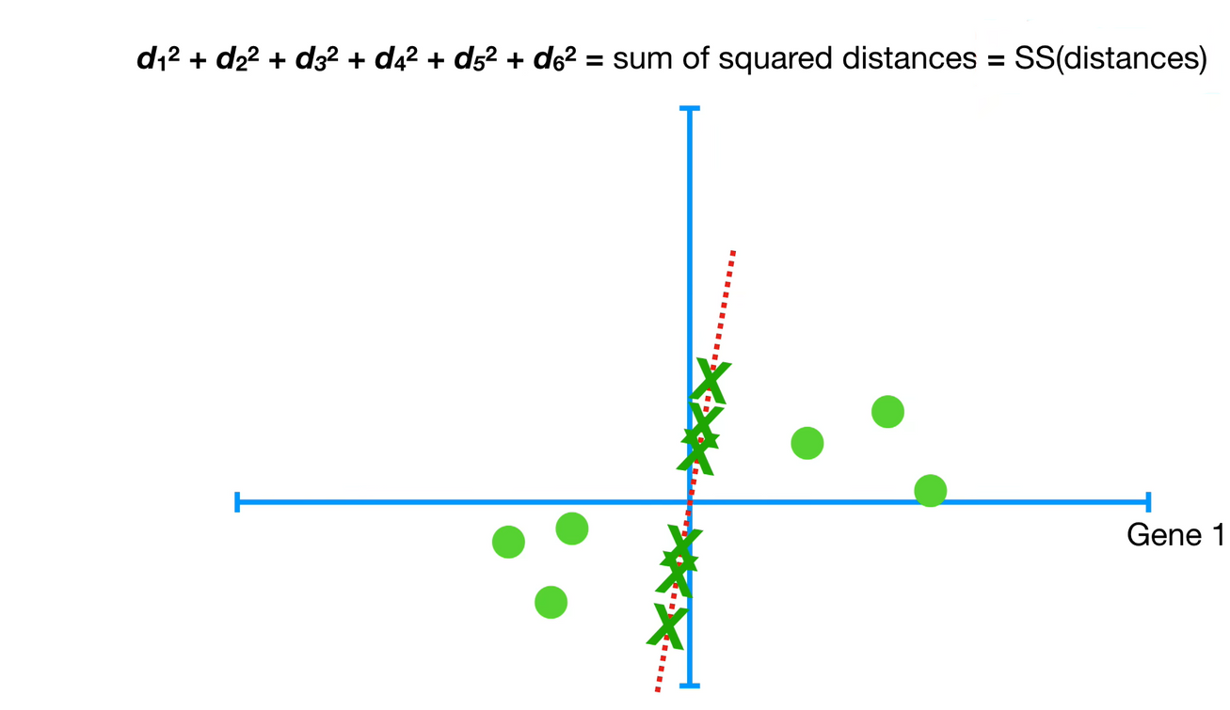
The distance are squared so the negative’s values don’t cancel out positive values
Now we rotate the line and project the data onto line
2020
Next Page

Slide 13
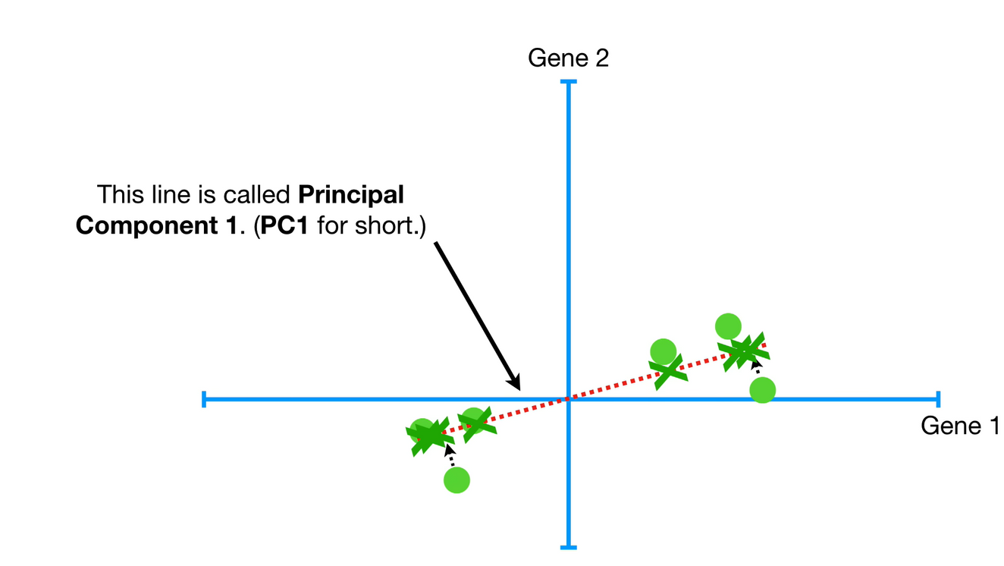
We repeat until we end up with the line with the largest sum of squared distance between the projected points and the origin
PC1 have the solpe of 0.25. In other words for every 4 units that we go out along the gene 1 axis and we go up 1 unit along the gene 2 axis
That means that the data are mostly spread out along the gene 1 axis and only little bit spread out along the gene 2 axis
2020
Next Page

Slide 14
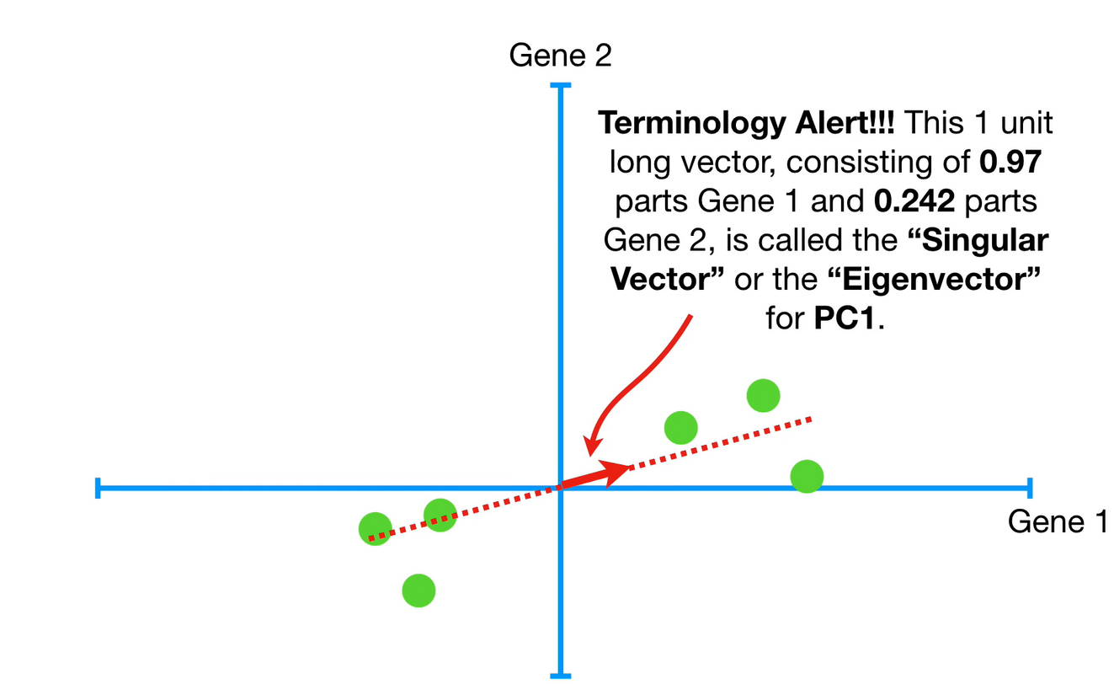
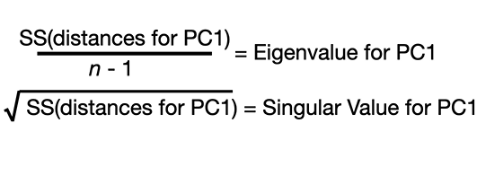
2020
Next Page

Slide 15
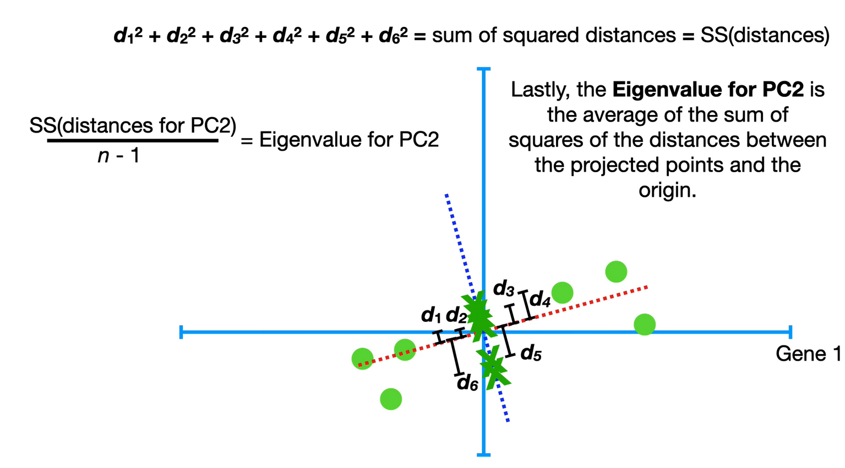
2020
Next Page

Slide 16
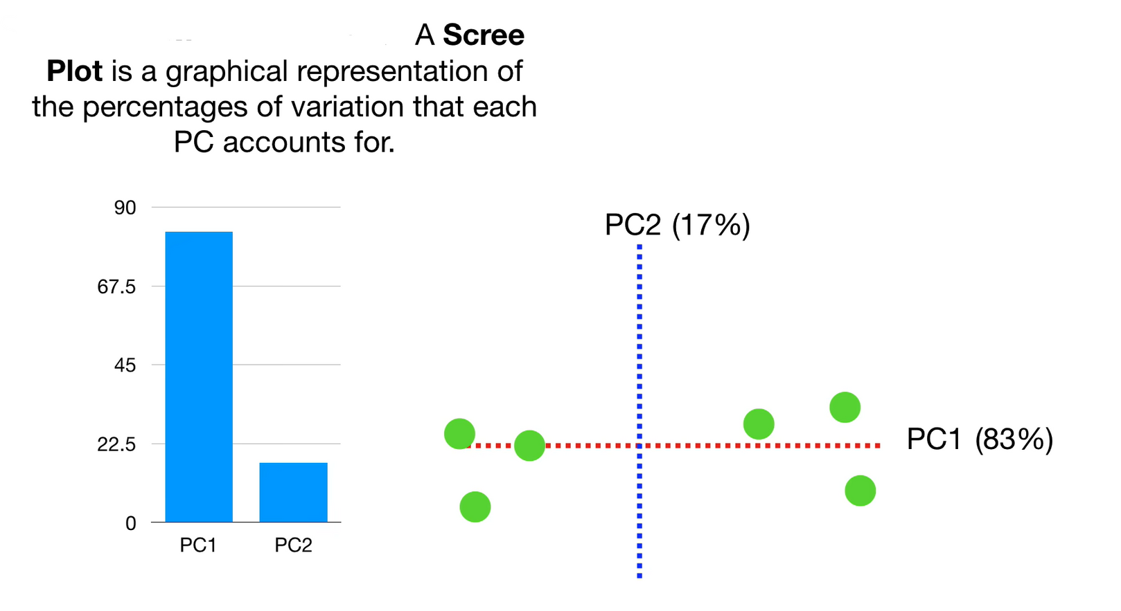
2020
Next Page

Slide 17
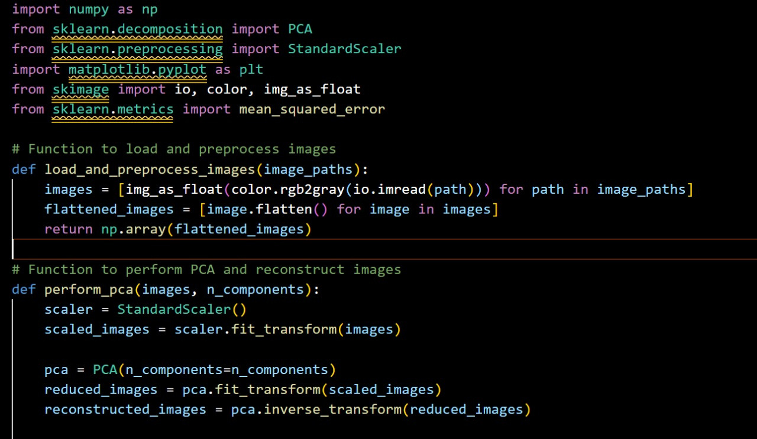
Let’s See hot to implement PCA via code
Next Page

Slide 18

Next Page

Slide 19
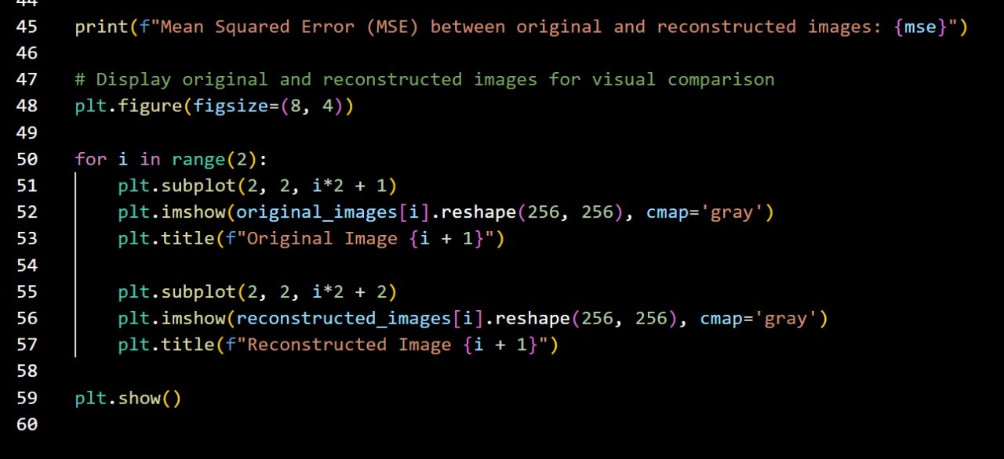
Next Page

Slide 20
Let’s look some Application
Genomics and Bioinformatics: In genomics, PCA is used to analyze gene expression data and identify patterns among different samples or conditions. By reducing the dimensionality of the data, PCA can reveal underlying relationships between genes or samples, helping researchers understand gene function, identify disease biomarkers, or classify different types of cancers.
Neuroscience: PCA is used to analyze functional Magnetic Resonance Imaging (fMRI) data to identify patterns of brain activity associated with different tasks or stimuli. By reducing the dimensionality of brain imaging data, PCA can help identify regions of the brain that are activated together, leading to insights into brain function and connectivity.
Chemometrics: In chemistry, PCA is used to analyze spectroscopic data from techniques such as mass spectrometry or chromatography. PCA can help identify patterns in complex chemical mixtures, such as distinguishing between different compounds or monitoring chemical reactions.
Environmental Science: PCA is used to analyze environmental data, such as water quality measurements or air pollution monitoring data. By reducing the dimensionality of the data, PCA can help identify underlying factors contributing to environmental variability and assess the impact of different pollutants or environmental factors.
Remote Sensing: In remote sensing, PCA is used to analyze satellite imagery data to identify patterns and features on the Earth's surface. PCA can help reduce the dimensionality of the data while preserving important spatial information, allowing researchers to identify land cover types, monitor deforestation, or track changes in environmental conditions over time.
Material Science: PCA is used to analyze data from techniques such as X-ray diffraction or spectroscopy to study the properties and composition of materials. PCA can help identify patterns in complex material datasets, such as distinguishing between different crystal structures or phases, and understand the relationships between material properties and composition.
Next Page

Slide 21
Some more Application
Finance: In finance, PCA is used to reduce the dimensionality of financial data, such as stock prices, to identify underlying factors driving the movements in the market. It helps in portfolio optimization, risk management, and asset allocation.
Image Compression: In image processing, PCA can be used to reduce the dimensionality of images while preserving their essential features. This is particularly useful in image compression techniques, where large images need to be stored or transmitted efficiently.
Genomics: In genomics, PCA is applied to gene expression data to identify patterns and correlations among genes. It helps in clustering similar genes and understanding the underlying biological mechanisms.
Marketing and Customer Segmentation: PCA can be used in marketing to analyze customer data and identify groups of customers with similar behavior or preferences. This helps businesses in targeted marketing strategies and customer segmentation.
Medical Imaging: In medical imaging, PCA can help in reducing the dimensionality of complex imaging data, such as MRI or CT scans, while retaining important diagnostic information. It aids in visualization, feature extraction, and pattern recognition.
Manufacturing and Quality Control: PCA is used in manufacturing industries to analyze and monitor the quality of products by reducing the dimensionality of multivariate data obtained from sensors or quality control processes. It helps in detecting anomalies and improving product consistency.
Climate and Environmental Sciences: PCA is applied to climate and environmental data to identify patterns and trends in variables such as temperature, precipitation, and atmospheric composition. It helps in understanding climate variability and predicting future changes.
Chemometrics: In chemistry, PCA is used to analyze complex data from spectroscopic techniques like mass spectrometry and chromatography. It helps in identifying chemical components, detecting outliers, and classifying samples.
Next Page

Slide 22
Future
Looking ahead, PCA is poised to continue playing a significant role in data analysis and machine learning. As technology advances and the volume of data grows exponentially, PCA's ability to handle high-dimensional datasets and extract meaningful information will become increasingly valuable. Moreover, with the emergence of more sophisticated algorithms and computational techniques, we can expect further refinements and enhancements to PCA, enabling it to address even more complex and diverse datasets. Additionally, PCA is likely to find applications in new domains and industries as researchers and practitioners uncover novel ways to leverage its capabilities. Overall, the future of PCA appears promising, with ongoing research and innovation paving the way for its continued evolution and adoption in data-driven decision-making processes.
Conclusion
"Principal Component Analysis (PCA) stands as a powerful mathematical tool with widespread applications across various fields. By extracting essential information from high-dimensional datasets, PCA aids in dimensionality reduction, data visualization, and pattern recognition. Its ability to uncover underlying structures and relationships within data facilitates better decision-making processes in fields ranging from finance and marketing to genomics and image processing. As we continue to delve into the realm of data analysis and exploration, PCA remains a cornerstone technique, providing valuable insights and paving the way for further advancements in understanding complex datasets."
Next Page

Slide 23


